Slide 1
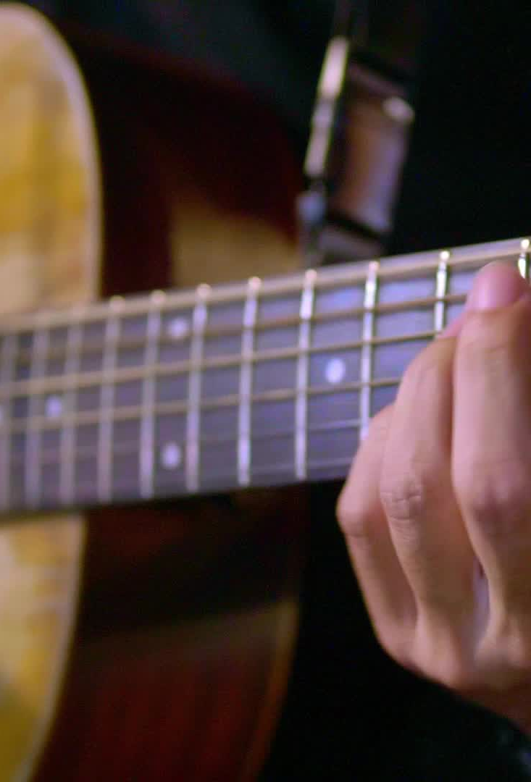
Amazing Grace (my Chains are Gone)
Andy Harrison, BJ Pridham, Mitch Wong
© 2016 Planetshakers Ministries Int. Inc. (Admin. by Music Services, Inc.)
CCLI Licence No. 5485849

Slide 2
Verse 1
Amazing grace how sweet the sound
That saved a wretch like me
I once was lost, but now I'm found
Was blind, but now I see

Slide 3
Verse 2
'Twas grace that taught my heart to fear
And grace my fears relieved
How precious did that grace appear
The hour I first believed

Slide 4
Chorus
My chains are gone, I've been set free
My God, my Savior has ransomed me
And like a flood His mercy reigns
Unending love
Amazing grace

Slide 5
Verse 3
The Lord has promised good to me
His word my hope secures
He will my shield and portion be
As long as life endures

Slide 6
Chorus
My chains are gone, I've been set free
My God, my Savior has ransomed me
And like a flood His mercy reigns
Unending love
Amazing grace

Slide 7
Verse 4
The earth shall soon dissolve like snow
The sun forbear to shine
But God, who called me here below
Will be forever mine, will be forever mine
You are forever mine

